Slide 1
RAy- A Distributed Python Framework

Slide 2
1.
What is distributed Programming ?
Distributed Programming is the art of solving the same computer problem that you can solve on a single computer using multiple computers

Slide 3
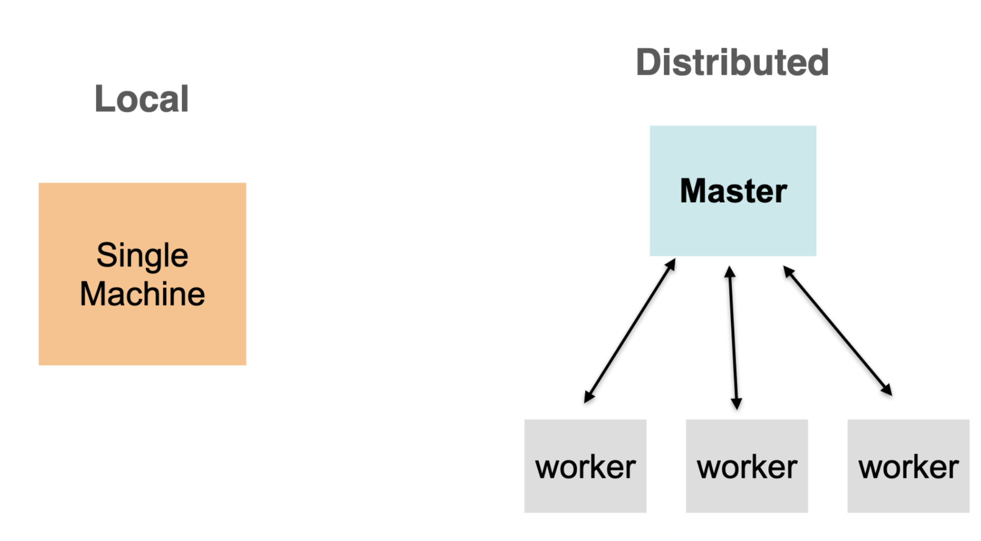
What is Distributed Systems

Slide 4
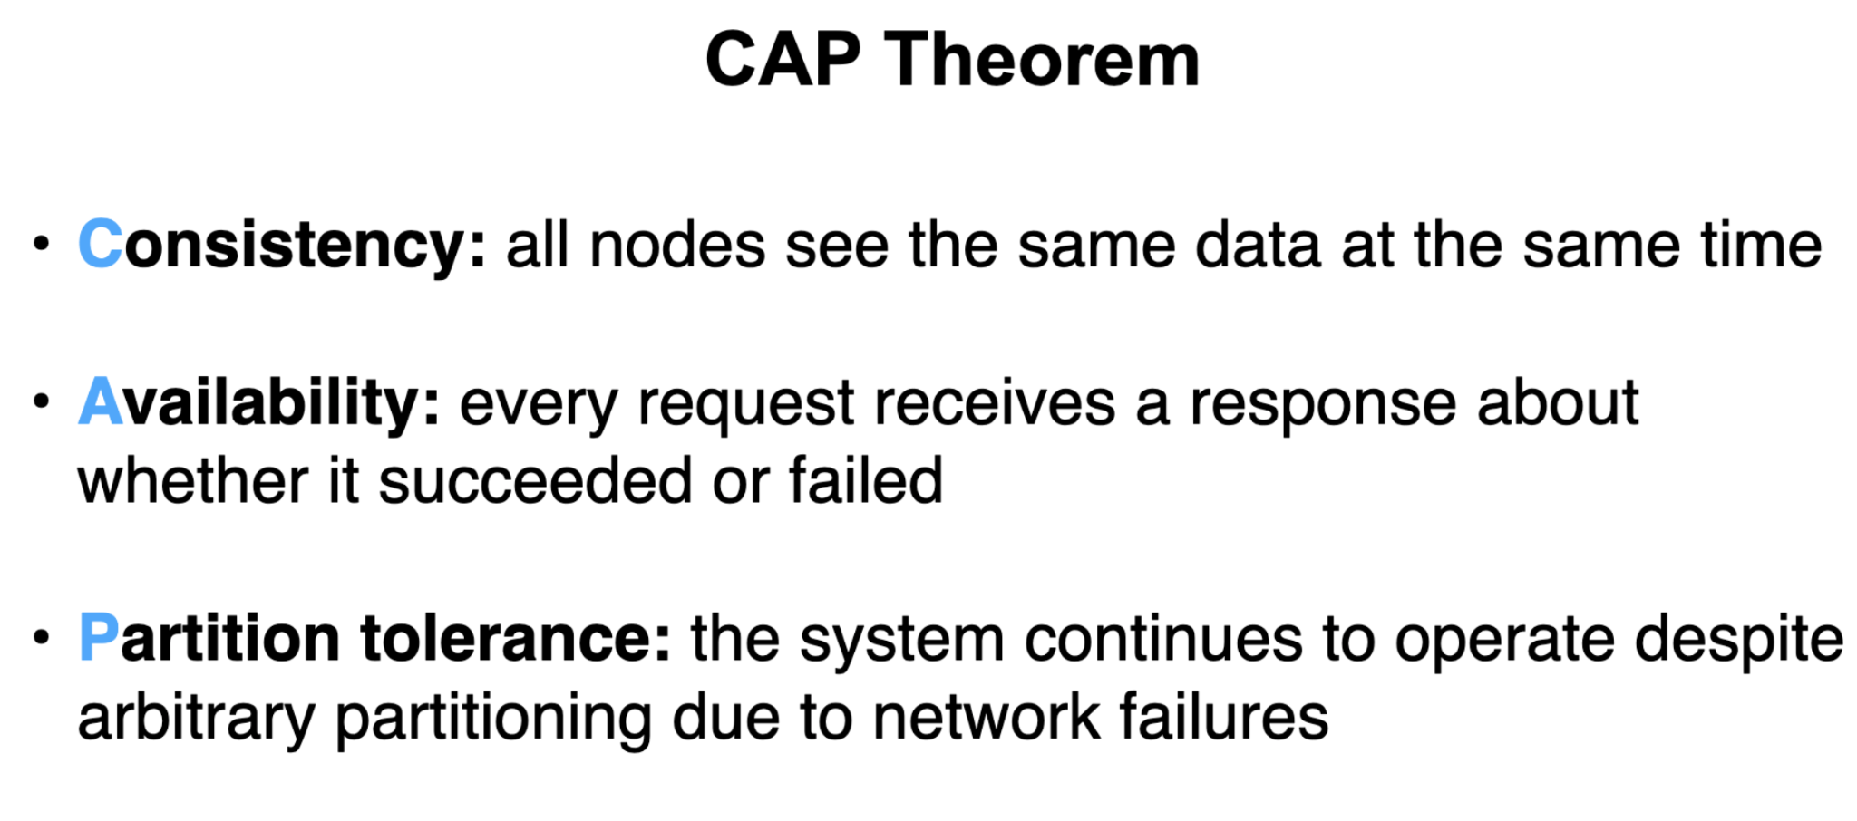
What is CAP Theorm

Slide 5
1.
What is Ray ?
Ray is an open-source project that makes it simple to scale any compute-intensive Python workload — from deep learning to production model serving. With a rich set of libraries and integrations built on a flexible distributed execution framework

Slide 6
What is Ray
Primitives for running fault tolerant distributed applications
Parallelize Single machine code with little to zero code changes
Large ecosystem of applications/libraries/tools on top of Ray Core

Slide 7
Ray Architecture and Design
Task — A single function invocation that executes on a process different from the caller. A task can be stateless or stateful .
Object — An application value. This may be returned by a task or created through `ray.put`. Objects are immutable: they cannot be modified once created. A worker can refer to an object using an `ObjectRef`.

Slide 8
Ray Architecture and Design
Actor — a stateful worker process (an instance of a `@ray.remote` class). Actor tasks must be submitted with a handle, or a Python reference to a specific instance of an actor.
Driver — The program root. This is the code that runs `ray.init()`.

Slide 9
Ray Architecture and Design
Job — The collection of tasks, objects, and actors originating (recursively) from the same driver

Slide 10
BIG CONCEPT

Slide 11
Ray Workflow
Lifetime of a Task
Lifetime of an Actor
Lifetime of an Object

Slide 12
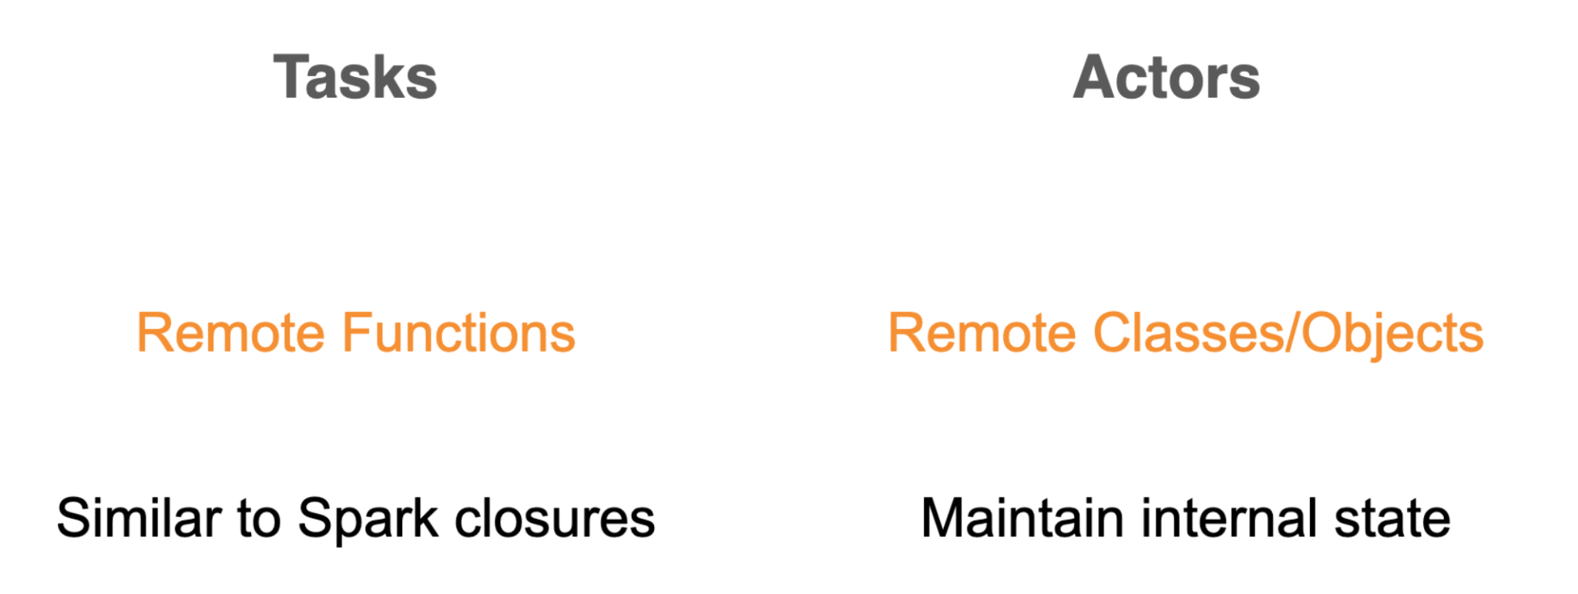
Tasks and Actors

Slide 13
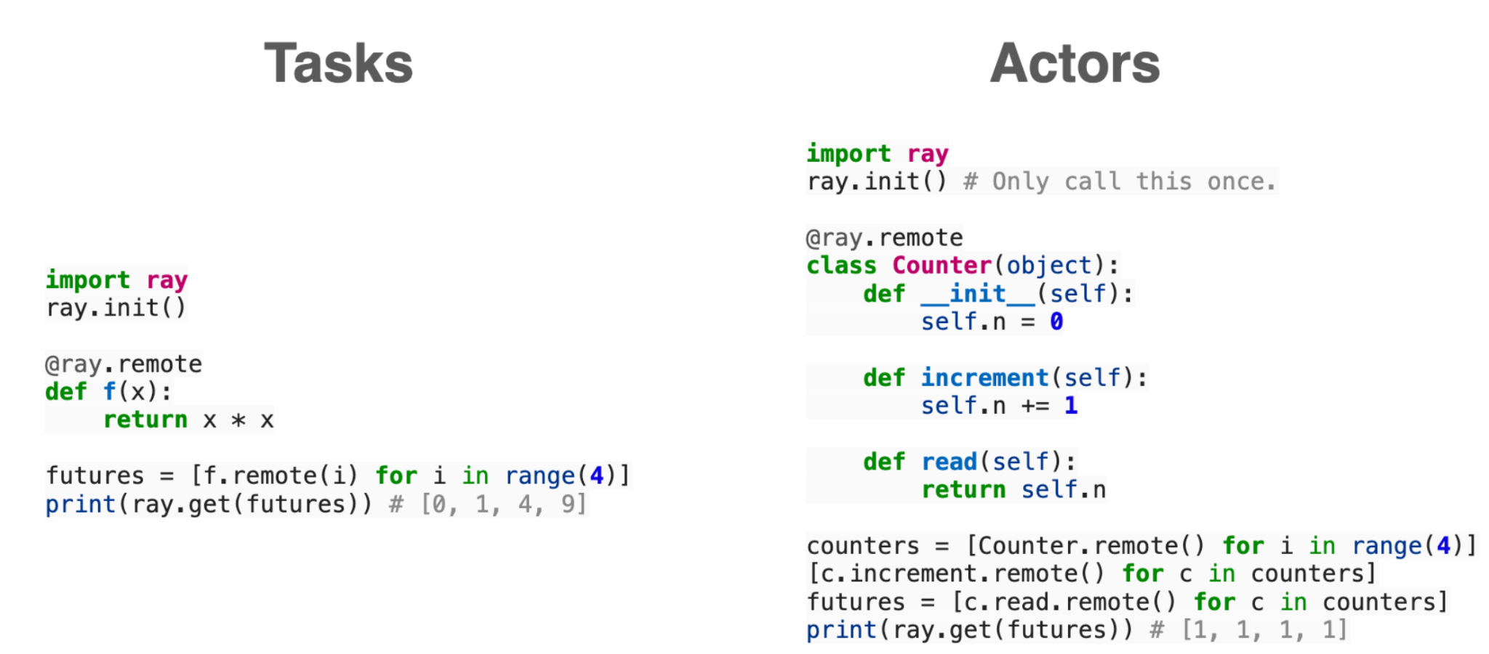
Differences

Slide 14
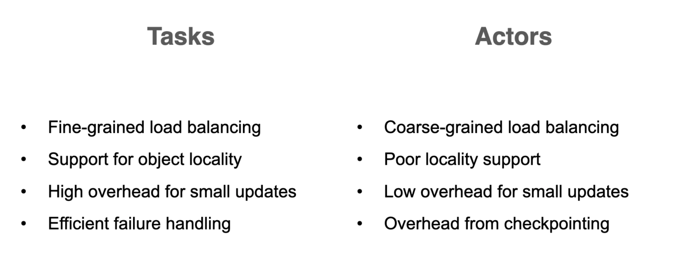
differences

Slide 15
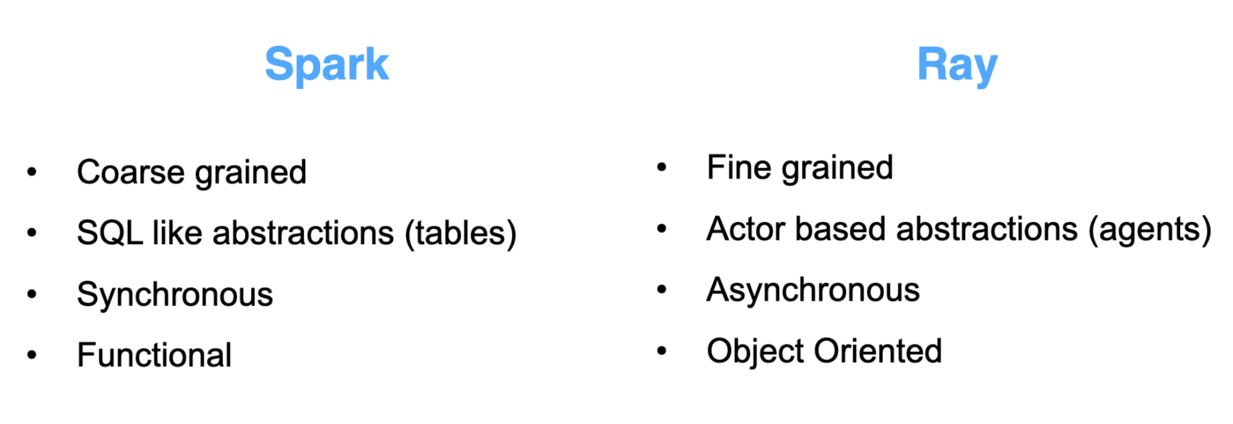
Differences

Slide 16
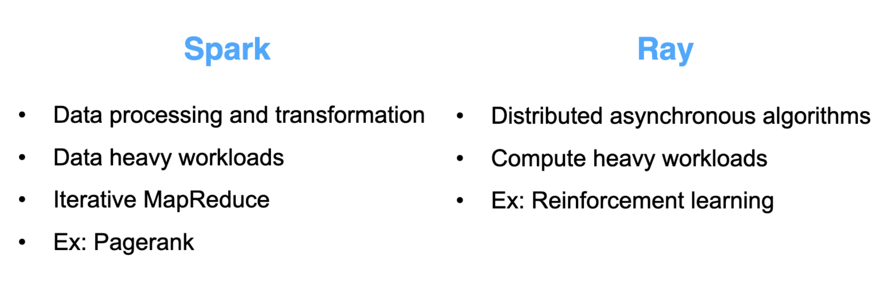
Differences

Slide 17
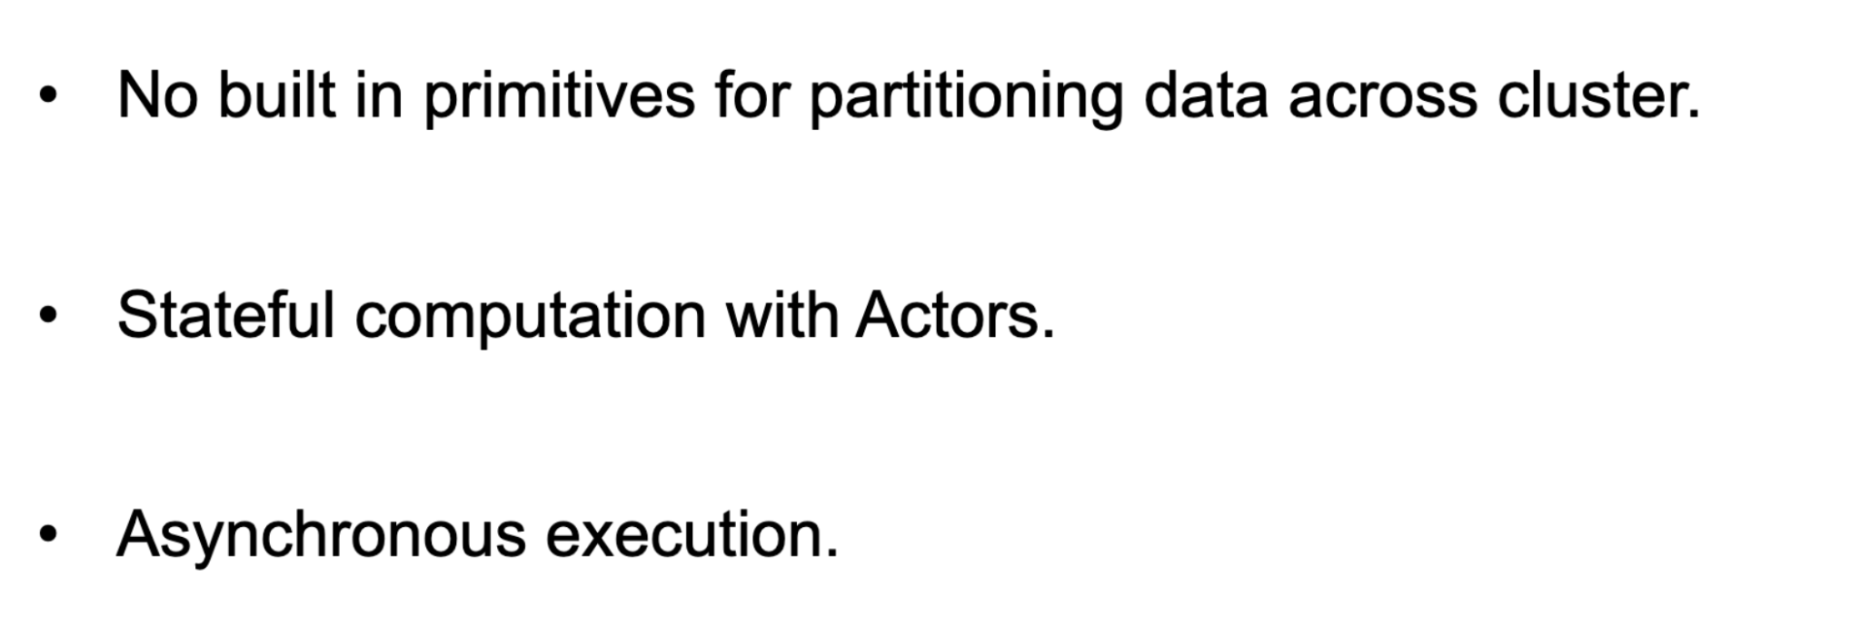
Differences From Spark

